Slide 1
PyData 2018 outbrief
You might get a refresher on python.
you might learn about cool data science solutions.
You may even learn about who’s an engineer or an actor on Cw.
But no matter what, I promise, we’ll have a lot of fun doing it.

Slide 2
What we’ll cover today This format is 100% inspired on PyData’s format
What is a PyData?
A… normal… Python Refresher
Whose Data Science is it Anyway
The Radar Meme Team: Engineering Division
Wrap Up

Slide 3
The Hierarchy of Fun
Python is an open source scripting language, similar to MATLAB.
At Radar, we use it to make .sstressin files, run our Automation Regression Runs to test SSTRESS, run the Tactical Automation Runs, and experiment with new (for us) Data Science approaches.
Many of the packages in Python are funded and managed by an organization called NumFocus.
Python Packages = MATLAB Toolboxes… just free.
NumFocus keeps the lights on by holding conferences named PyData
PyData talks about, spoiler alert, Python & Data Science
I went to PyData NYC but there is still time for you to go to PyData DC, featuring many of the same speakers, at a lower price (especially when you consider DC hotels being cheaper)
Workshop Tutorials on Fri Nov 16 & Presentation Speakers on Sat Nov 17 – Sun Nov 18
~ $370 for three days, though this becomes $575 if Lockheed pays and it becomes $210 if you’re a student.

Slide 4
What we’ll cover today This format is 100% inspired on PyData’s format
What is a PyData?
A… normal… Python Refresher
Whose Data Science is it Anyway
The Radar Meme Team: Engineering Division
Wrap Up

Slide 5
Mistakes made besides lisa lowrie hiring me
My Python Lunch & Learns are always tricky for me because there are three types of people who come to these things
Inexperienced Python Engineers (I’m so glad you’re here, thanks for having the interest to come by!)
Experienced Python Engineers (who want to be blown away with something new)
People here for Matt’s Comedy Hour (btw, you can find snakes at the Hiss-issippii River)
4 Lunch & Learns & one PyData 2018 later, I think I finally saw the light on how to handle this.
Please take this opportunity, if you haven’t yet, to grab a piece of paper or to use your phone because we’re about to play…

Slide 6
Python Refresher Trivia!
Yes, I actually do need you to grab a piece of paper or use your phone to jot down answers.
Be sure to jot your answers quickly, this will go somewhat fast.
The person in first place will win amazing prizes.
This Quiz was written with the same professionalism Matt Widjaja exhibits on a daily basis.
In other words, don’t take this too seriously.
But, every question will legitimately cover valid Python 3 code & principles.
Yes, this is how they did it at PyData 2018 and it was hysterically helpful.

Slide 7
Test Section: Python at LM Radar Engineering
These questions do not count, they’re just an example, but the answers are legitimately real.

Slide 8
Example Question What is Matt Widjaja’s favorite part about anaconda here at Lockheed?
That Anaconda is still Python, just with many Python Packages bundled in.
That Anaconda comes with Spyder, a MATLAB styled graphical interface to code & debug Python.
That Anaconda is FOSS Approved for you to install on your unclassified PC without an Admin.
That Anaconda is not NSFW.
Countdown to next question
Time is up
Notes:
19.5 Seconds: 4 1.5 Seconds & 18 0.75 Seconds

Slide 9
Example Question PyData is writing the next ‘jenny’ song – which Python Executable/version does pydata want you to use here at radar?
Assume that all paths are <YOUR ANSWER>/bin/python
/sw/anaconda2.0.1
/sw/anaconda4.0.0
/sw/anaconda3-5.0.1
/sw/python2.7.1
Countdown to next question
Time is up
Notes:
24 Seconds: 4 1.5 Seconds & 18 1 Seconds

Slide 10
Answer to Example Question What is Matt Widjaja’s favorite part about anaconda here at Lockheed?
That Anaconda is Python, with many Python Packages bundled in automagically.
This is true, you don’t have to install key packages like Matplotlib, Pandas, & Numpy with Anaconda.
That Anaconda comes with Spyder, a MATLAB styled graphical interface to code & debug Python.
This is true, you can find Spyder in /sw/anaconda*/bin/spyder
We’ll talk about that ‘*’ in a sec – it’s because we have several versions.
That Anaconda doesn’t require admin rights to install on your Unclassified Laptop & is FOSS approved
This is true, you can find it in the FOSS_APPROVED folder.
That Anaconda isn’t NSFW.
This is the correct answer. I’m already in enough trouble as is.

Slide 11
Answer to Example Question which Python Executable/version would pydata want you to use here at radar?
Assume that all paths are <YOUR ANSWER>/bin/python
/sw/anaconda2.0.1
We have legacy code using this distribution of Python 2.7.1. Try to not make new scripts using this.
/sw/anaconda4.0.0
This distribution of Python 3 is being quickly deprecated in favor of the next option.
/sw/anaconda3-5.0.1
+1 Points for being most correct. This contains Python 3.6 & Python Packages. Use this whenever possible or at the minimum, if you’re using another Python distribution, make sure your script could work with this.
/sw/python2.7.1
+1 Points for Compatibility. This distribution may be deprecated by the world, but we still use it a lot here, especially because it could be the only option you have on non System 39 machines.
Notes:
24 Seconds: 4 1.5 Seconds & 18 1 Seconds

Slide 12
Section 1: Basics of Python
8 Questions; 18.5 Seconds per Question

Slide 13
Question 1 What is the most correct way to print x to the screen?
print x
print(x)
x.print
public class PrintX { public static void main(String[] args) { System.out.println(x); } }
Countdown to next question
Time is up
Notes:
13 Seconds (.5*18) + (4*1)

Slide 14
Question 2 Which of these variable declarations are wrong?
never_gonna_give_you_up = True
never_gonna_let_you = ‘down’
never_gonna_run_around = 1
never_gonna_say_good = “bye”;
and_desert_you = 2.0
Countdown to next question
Time is up

Slide 15
Question 3 How should I list the ways 137 is falling apart, so that I can add to it later?
These use square brackets
building = [“Network”, “AC”, ”Roof”, “Restroom”]
building = [“Network”; “AC”; ”Roof”; “Restroom”]
These use parentheses
building = (“Network”, “AC”, ”Roof”, “Restroom”)
building = (“Network”; “AC”; ”Roof”; “Restroom”)
Countdown to next question
Time is up

Slide 16
Question 4 What color is this dress?
Assume that x = [‘Purple and White’, ‘Gold and White’, ‘Black and Blue’]
x[0]
x[1]
x[2]
x[3]
Countdown to next question
Time is up

Slide 17
Question 5 How should joe palladino create an object to ensure nobody can change this person’s status
status = [‘Matt Widjaja’, ‘Fired’]
status = (‘Matt Widjaja’, ‘Fired’)
status = {‘Matt Widjaja’: ‘Fired’}
They finally managed to get rid of him?!?
Countdown to next question
Time is up

Slide 18
Question 6 Which of these if statements, testing common truths, will never print anything out?
lm_healthworks = True if lm_healthworks: print(‘You have great Insurance’)
aspep_pos = True if aspep_pos == True: print(‘You have great Insurance’)
lm_high_deductible = True if not lm_high_deductible: print(‘You have great Insurance’)
Countdown to next question
Time is up

Slide 19
Question 7 Python 3 changed handling for unicode strings (binary/emoji). How would I print one?
print(unicode(‘\U0001FAA9’))
print(u'\U0001F4A9')
print(u'\U0001F4A9’.decode())
print(u'\U0001F4A9’.decode)
Countdown to next question
Time is up

Slide 20
Question 8 For Loop Question
print(unicode(‘\U0001FAA9’))
print(u'\U0001F4A9')
print(u'\U0001F4A9’.decode())
print(u'\U0001F4A9’.decode)
Countdown to next question
Time is up

Slide 21
Answer 1 What is the most correct way to print x to the screen?
print x
This is partially wrong. It works in Python 2 but we’re trying to switch from Python 2.
print(x)
+1 Point. This method will work in both Python 2 & Python 3.
x.print
This won’t return you anything.
public class PrintX { public static void main(String[] args) { System.out.println(x); } }
-1 Point. Don’t bring your Java here.

Slide 22
Answer 2 Which of these variable declarations are wrong?
never_gonna_give_you_up = True
This is how you declare a boolean for True or False
never_gonna_let_you = ‘down’
This is how you declare a String
never_gonna_run_around = 1
This is how you declare an integer (and it’ll stay an integer unless you force it into a float)
never_gonna_say_good = “bye”;
+1 Point. While you can declare a string with double quotes, the semi-colon at the end is unnecessary
and_desert_you = 2.0
This is how you declare a float for decimals

Slide 23
Answer 3 How should I list the ways 137 is falling apart, so that I can add to it later?
building = [“Network”, “AC”, ”Roof”, ”Bugs”, “Restroom”]
+1 Point. Use Square Brackets to create a ‘List’, which is an object you can add & edit.
building = (“Network”, “AC”, ”Roof”, ”Bugs”, “Restroom”)
This is a Python Tuple, which is an object you cannot add & edit after you create it.
building = [“Network”; “AC”; ”Roof”; ”Bugs”; “Restroom”]
Semi colons do not delimit lists
building = (“Network”; “AC”; ”Roof”; ”Bugs”; “Restroom”)
…And semi colons do not delimit tuples either

Slide 24
Answer 4 What color is this dress?
Assume that x = [‘Purple and White’, ‘Gold and White’, ‘Black and Blue’]
x[0]
Python is zero-indexed so this’ll return ‘Purple & White’… which science agrees isn’t this dress’ color
x[1]
This’ll return ‘Gold and White’ which science says is not the right answer.
x[2]
+1 Point. This’ll return ’Black and Blue’ which science says is right.
x[3]
The ’3’ index will return the 4th item in the list, which is nothing, so Python will crash.

Slide 25
Answer 5 How should joe create an object to ensure nobody can change this person’s status
status = [‘Matt Widjaja’, ‘Fired’]
This a List, which you can modify, delete, or add to after creation.
status = (‘Matt Widjaja’, ‘Fired’)
+1 Point. This is a Tuple, which you cannot modify, delete, or add to after creation, short of overwriting it
status = {‘Matt Widjaja’: ‘Fired’}
This is a Dictionary, which has fancy indexing schemes, but it can still be modified after the creation.
They finally managed to get rid of him?!?
Makes you wonder doesn’t it?

Slide 26
Question 6 Which of these if statements, testing common truths, will never print anything out?
lm_healthworks = True if lm_healthworks: print(‘You have great Insurance’)
aspep_pos = True if aspep_pos == True: print(‘You have great Insurance’)
lm_high_deductible = True if not lm_high_deductible: print(‘You have great Insurance’)
This will print something out. The if statement will see if lm_healthworks is true or if it exists. Because it is set to True, the print statement will run.
This will print something out. The if statement will see if aspep_pos is set to true. Because it is, the print statement will run.
+1 Points. This will not print something out. Besides being not true, the ‘not’ in the if statement will only cause this to run if this is False or if it does not exist.

Slide 27
Question 7 Which of these for statements is the most correct way to print a list of words out?
Assume x is this list of words.
for i in len(x): print(word)
for word in x: print(word)
for word in x.iteritems(): print(word)
This actually won’t run. Python does not use integer indexing to loop between lists unlike C++ & MATLAB.
+1 Point. Python will loop between each item in x here and print it out.
This actually won’t run. Python does not use integer indexing to loop between lists unlike C++ & MATLAB.

Slide 28
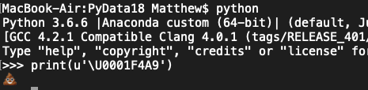
Question 7 Python 3 changed handling for unicode strings (binary/emoji). How would I print one?
print(unicode(‘\U0001FAA9’))
unicode() isn’t a valid function in Python
print(u'\U0001F4A9')
+1 Points. This will print a Unicode object and you’d store one in using similar syntax. This will print what you see to the right.
print(u'\U0001F4A9’.decode())
.decode() isn’t a valid attribute in Python
print(u'\U0001F4A9’.decode)
.decode isn’t a valid attribute in Python

Slide 29
Answer 8 Which of these for statements is the most correct way to print a list of words out?
Assume x is this list of words.
for i in len(x): print(word)
for word in x: print(word)
for word in x.iteritems(): print(word)

Slide 30
What we’ll cover today This format is 100% inspired on PyData’s format
What is a PyData?
A… normal… Python Refresher
Whose Data Science is it Anyway
The Radar Meme Team: Engineering Division
Wrap Up

Slide 31
Mistakes made besides lisa lowrie hiring me
…Another Lunch & Learn struggle I have, especially for Conference Outbriefs, is that there are so many topics, that I’ll either run out of time or bore half of you sporadically throughout my outbrief.
The cool news is that all sessions & tutorials will be uploaded to https://www.youtube.com/user/PyDataTV in the next 1-4 weeks.
My goal isn’t to summarize the presentations so that you can skip learning more, but rather, that if you’re interested, you’ll dive into the session videos, read the presentation, or chat with the speaker yourself.
So, to not completely spoil each presentation, I’ll explain each one… in 32 seconds or less.
I will spotlight 3-4 interesting topics, which I think are relevant to us, later today.
Legal Indemnity: I do not hold any responsibility for incorrect or overly simplified summaries.

Slide 32
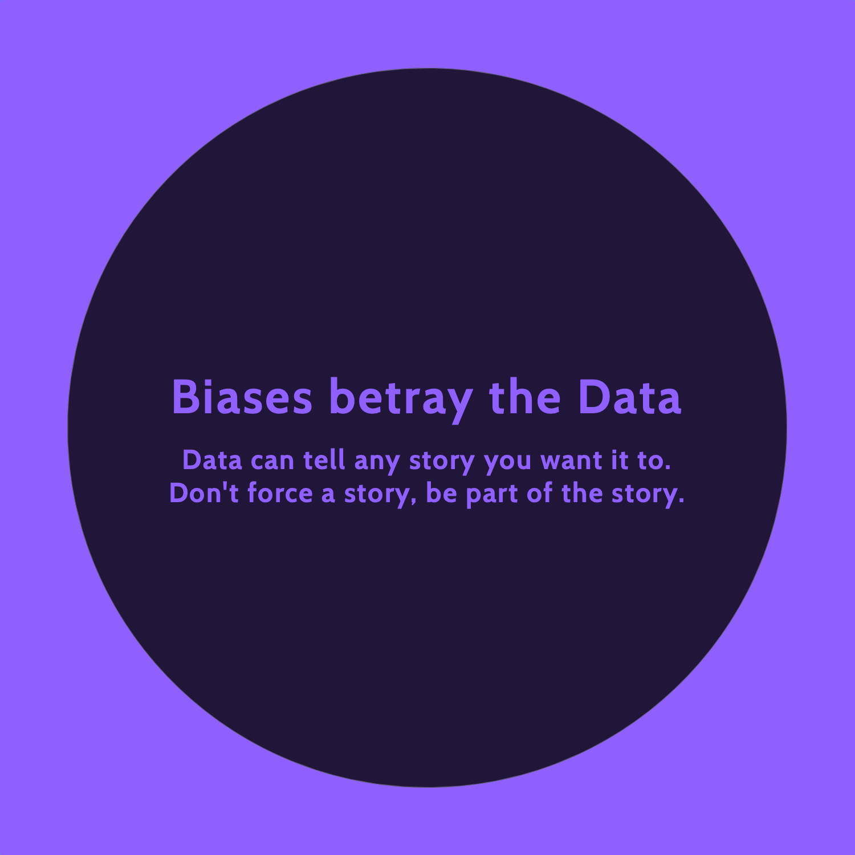
Hillary Green-Lerman Creating a data driven culture
Who’s who on the team?
Data Scientists create predictive models which provide precise answers.
Data Analysts create descriptive models which provide general answers.
Because data is now BIG, it needs to be democratized.
Discoverability: Dashboards help users discover data
Reportability: Email & Jira Notifications warn if something’s off
Investigative: Tools & Scripts help users dig into the data.
Countdown to next session
Unlike some presenters I had, I must move on
Notes:
33.5 Seconds: 4 2.25 Seconds & 18 1.25 Seconds

Slide 33
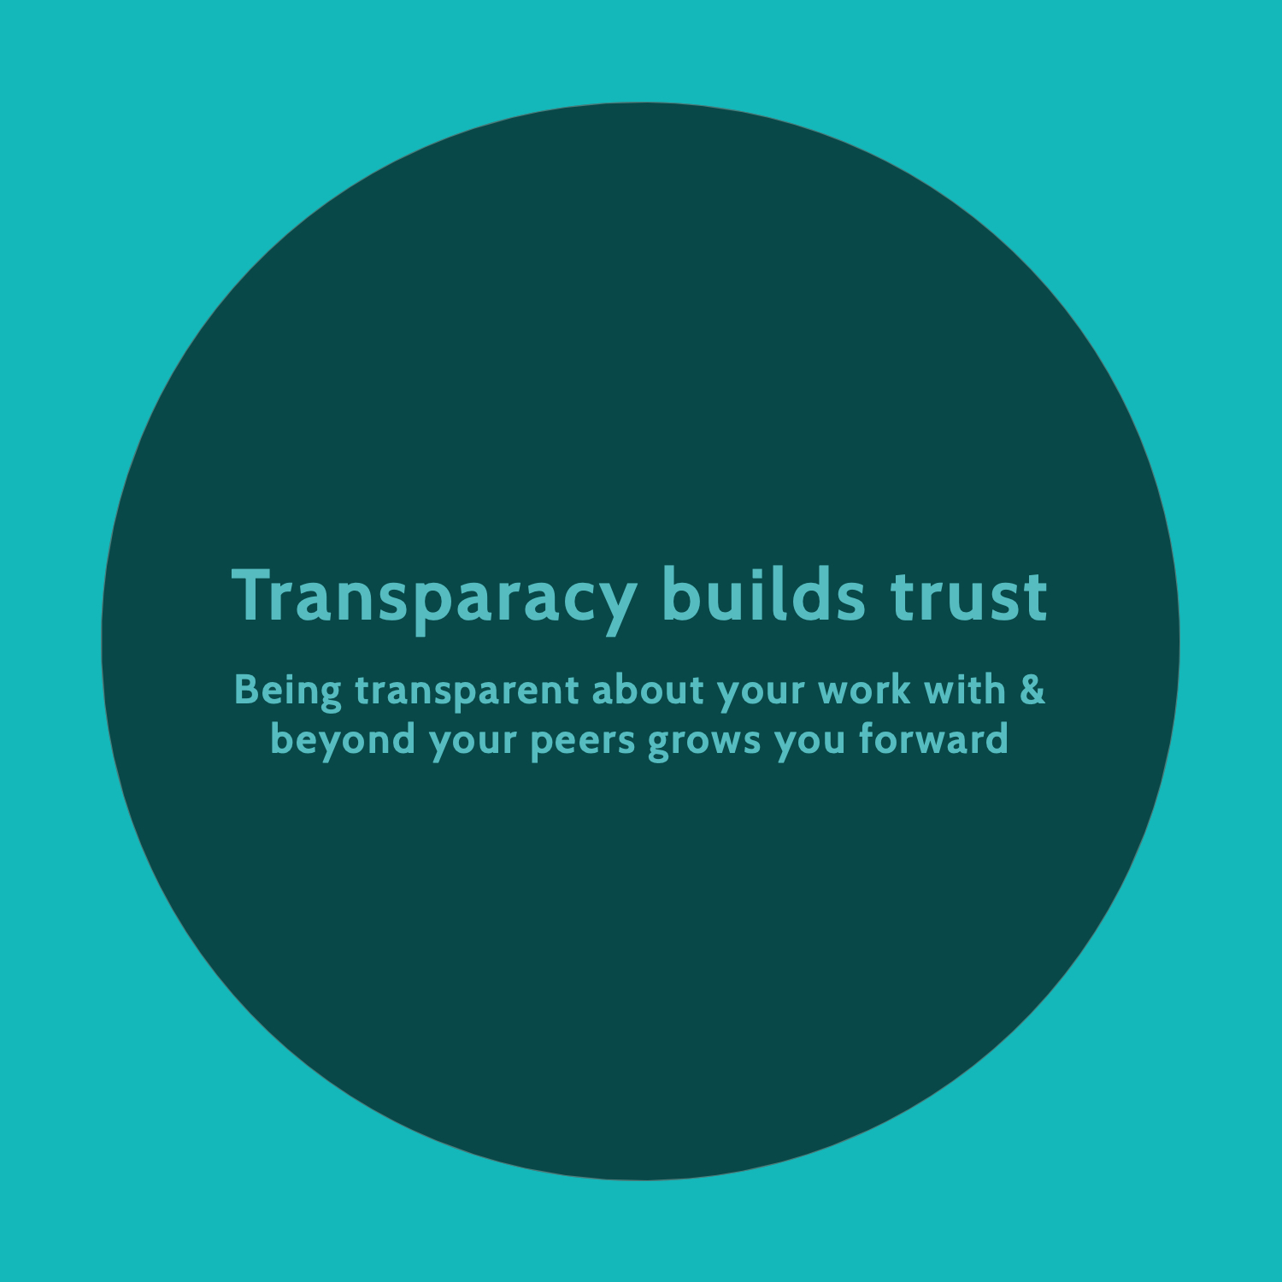
Travis Oliphant Business of Open Source
Multi-billion dollar companies are living off the generosity of a few.
Your capital & money tells me what you value.
Your capital is structured based on the relationships you have.
Business & Open Source are networks of people, cooperation, and competition.
Voluntary trade occurs in these networks when people find ‘win-win’ partnerships.
People voluntarily & independently work when the mission to discover these ‘win-win’ is fun.
Countdown to next session
Unlike some presenters I had, I must move on

Slide 34
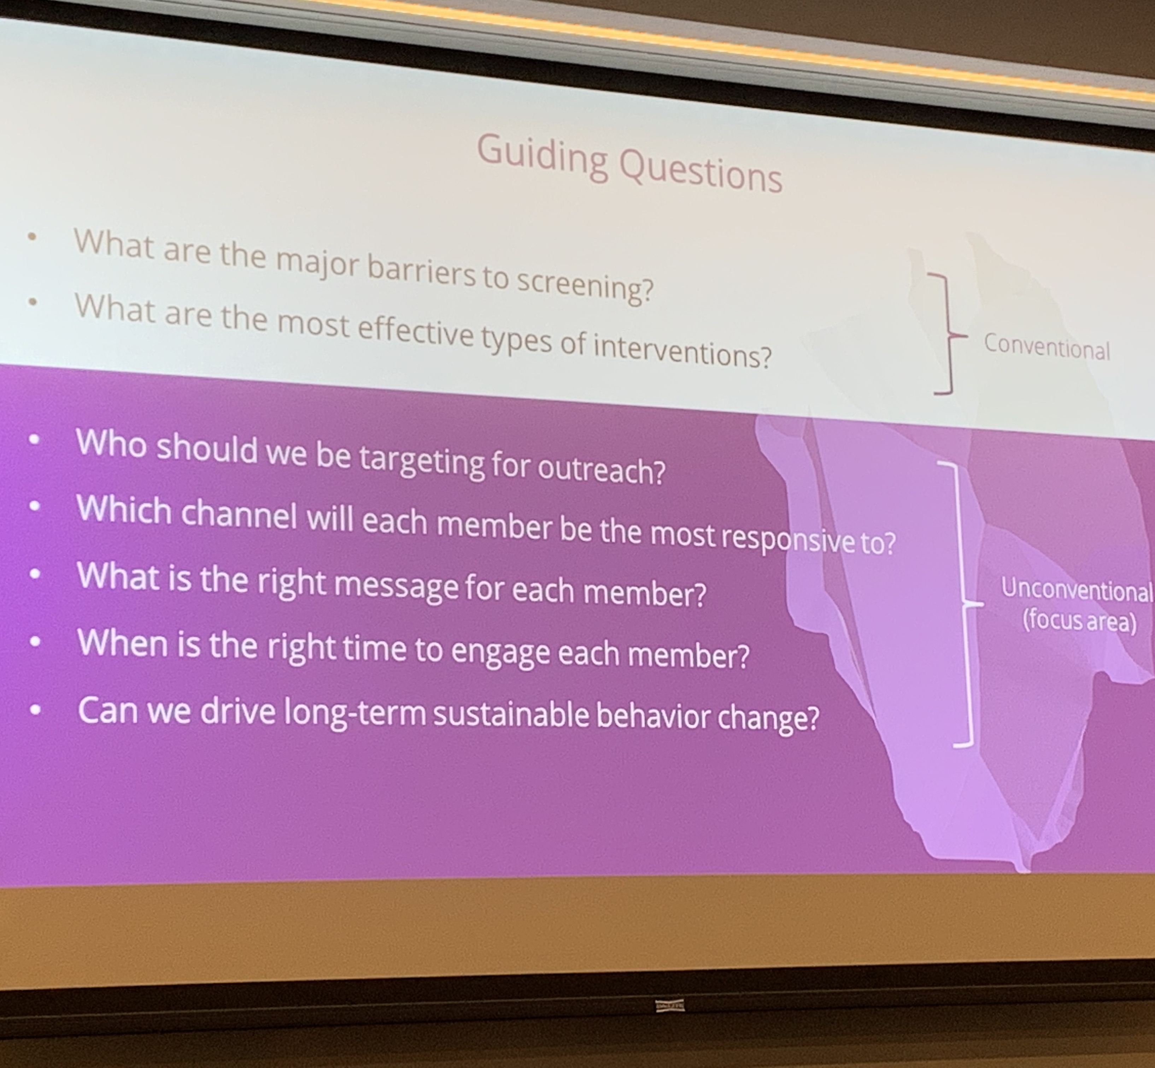
Piero Ferrante Breast Cancer
At Aetna, they’re deploying Machine Learning models to try to convince more women to get Breast Cancer Screenings.
[Image] Data Science now lets us ask personalized questions on how we can encourage screenings.
They used Machine Learning Models to identify these strategies
Medical History & Age determined: Nurse Call vs. Automated Call vs. Email
Location & Your Plan determined: “Get screened for you” vs. “Get screened for family”
Led to 25% increase in screenings year-over-year
Countdown to next session
Unlike some presenters I had, I must move on

Slide 35
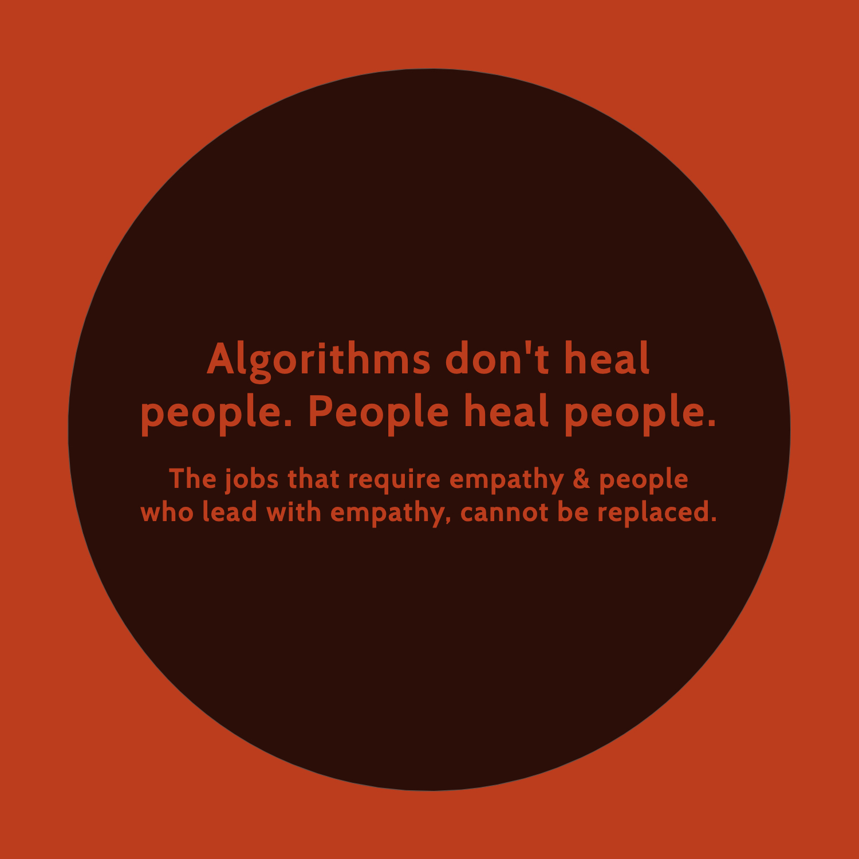
Michael Becker Data Science in Healthcare
Watson was able to detect cancer! Well… kind of.
Later studies said the AI model failed against Radiologists.
Also, the dataset used to train the model was flawed
We need to stop listening to the hype of Data Science in Healthcare and focus our energy on the right problems.
Fill in the Blank: If I knew [INFO], I would do [PLAN] to [OUTCOME]
Example: If I knew [Which patents are the most ill], I would make sure they get [Palliative Care], to improve their [Health].
Bonus : This is how not-CSL Agile recommends writing stories. As a [YOUR JOB], I want [PLAN], so [OUTCOME].
Countdown to next session
Unlike some presenters I had, I must move on

